Slide 1

Topic 1
Computer Organization

Slide 2
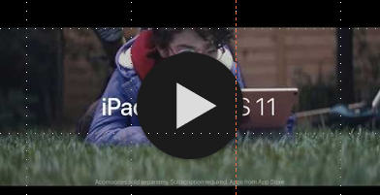
In January 2018, Apple published this TV spot showing its vision of the future…
How do you think this commercial was received?

Slide 3


Slide 4
What’s a computer?
What’s a computer?

Slide 5


Slide 6
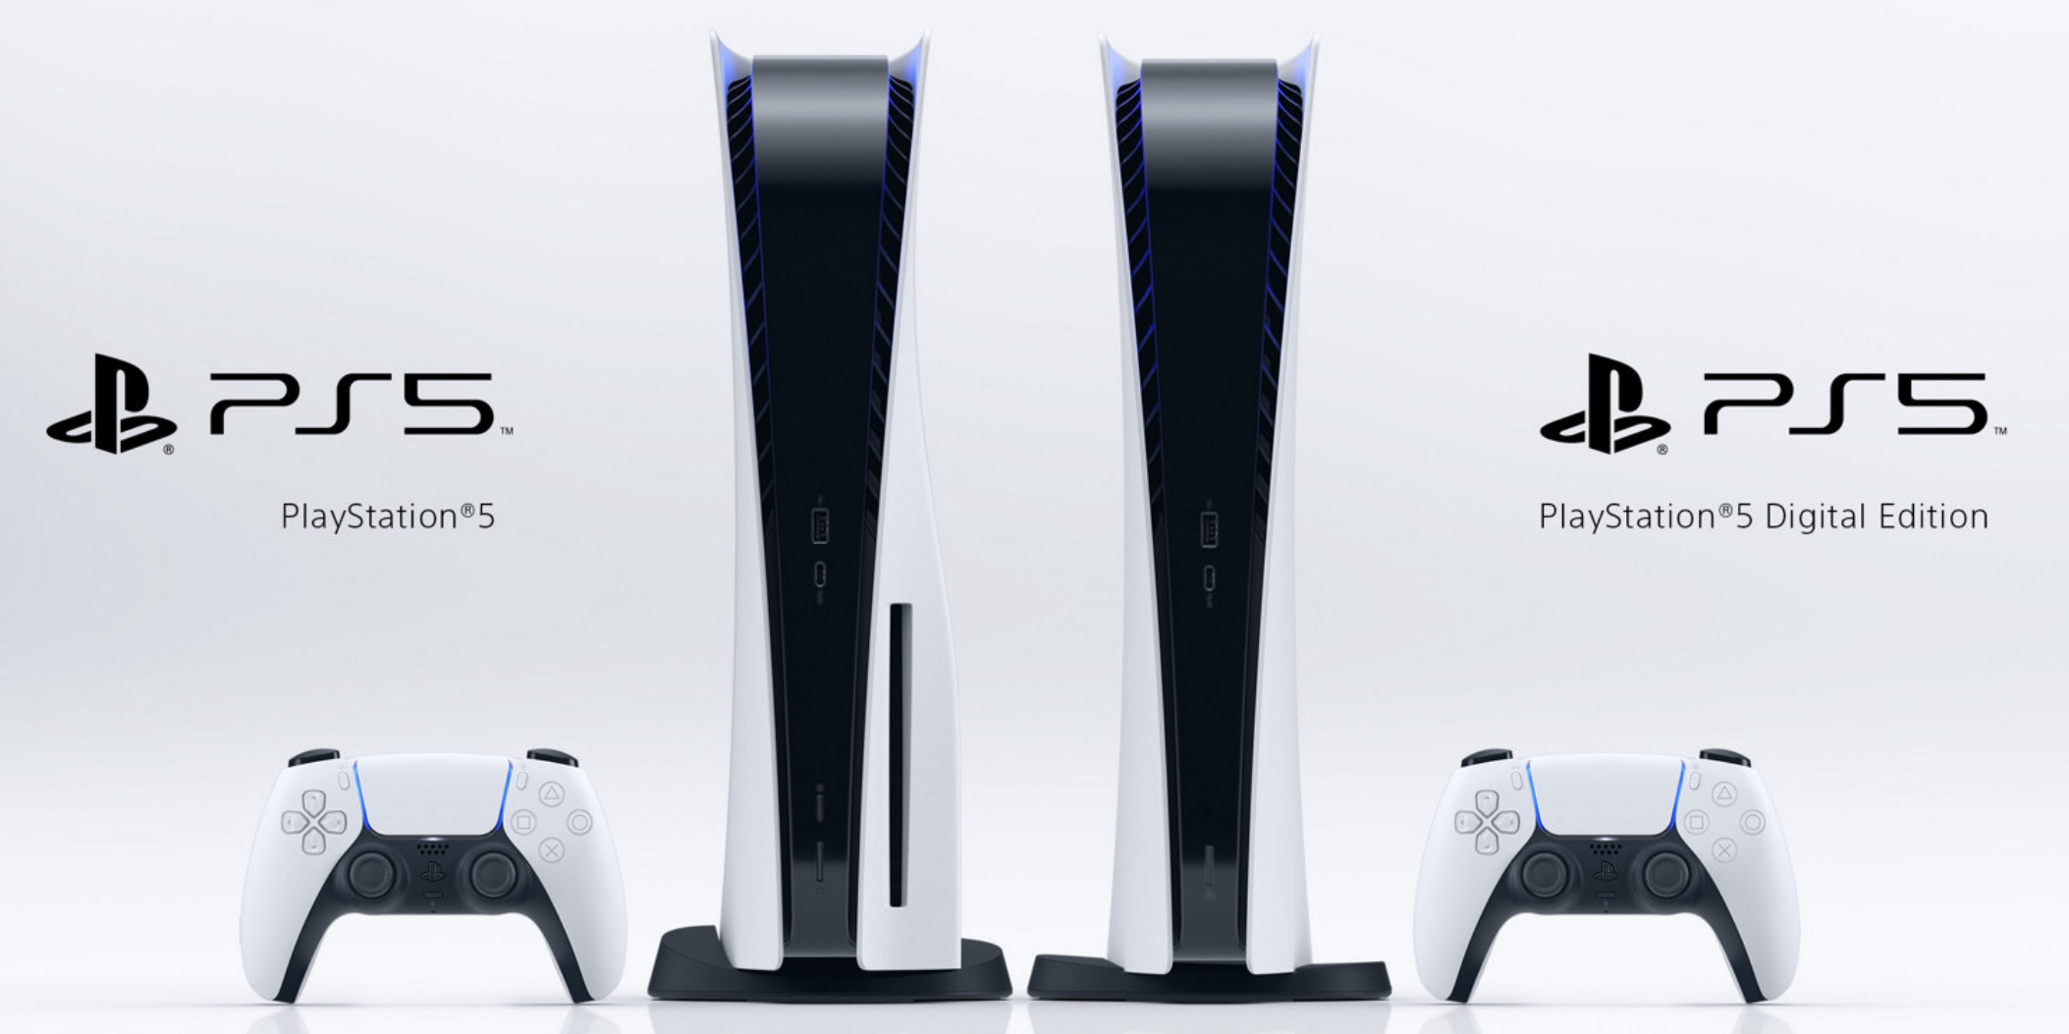

Slide 7
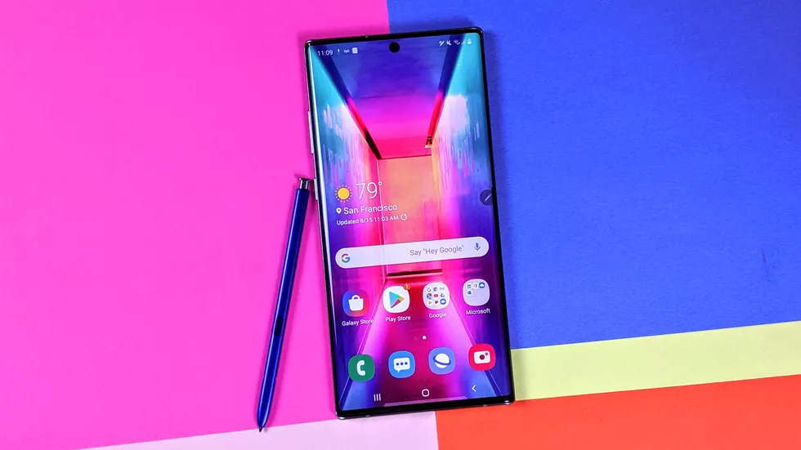

Slide 8
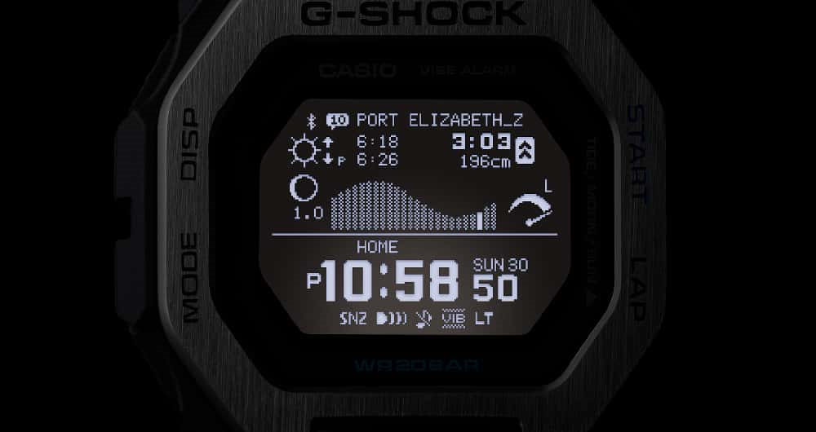

Slide 9
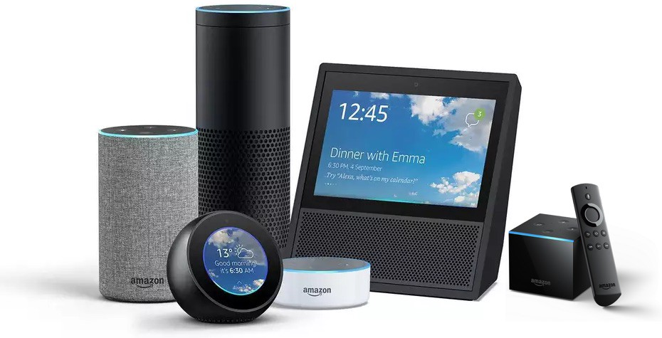

Slide 10
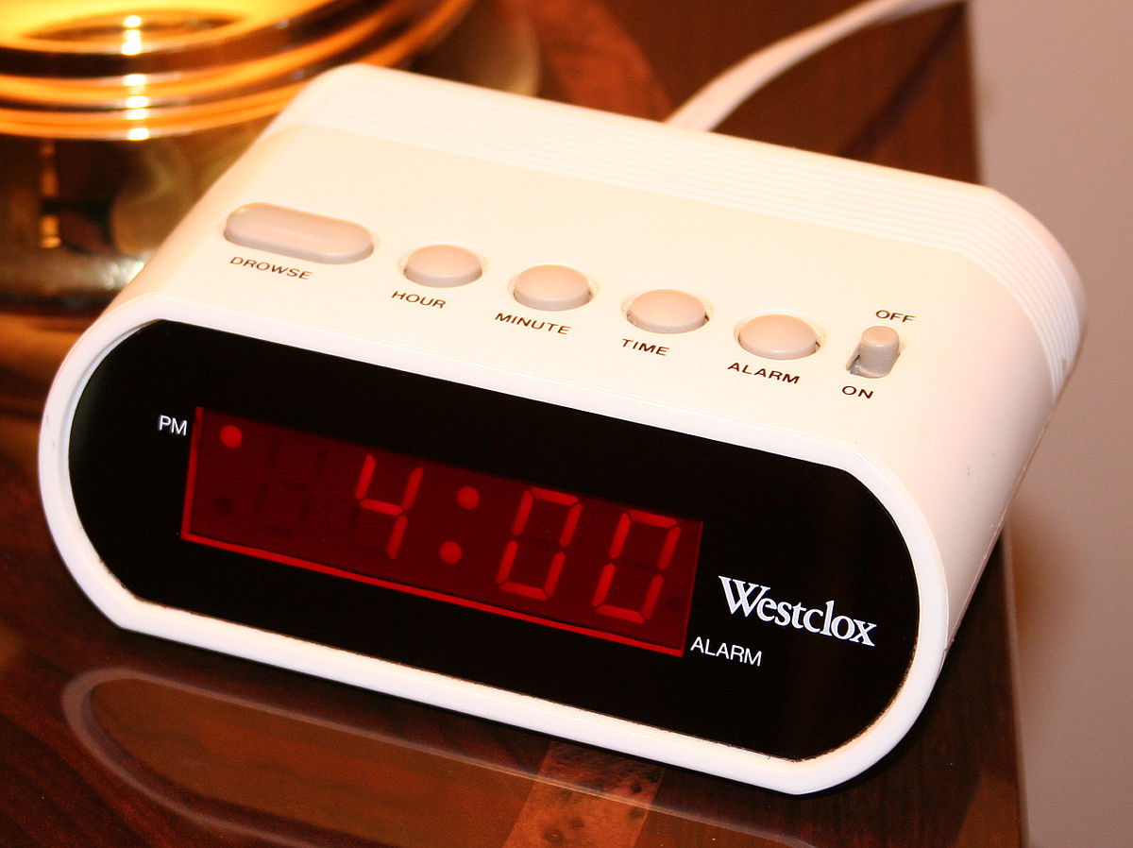
This Photo by Unknown Author is licensed under CC BY-SA

Slide 11
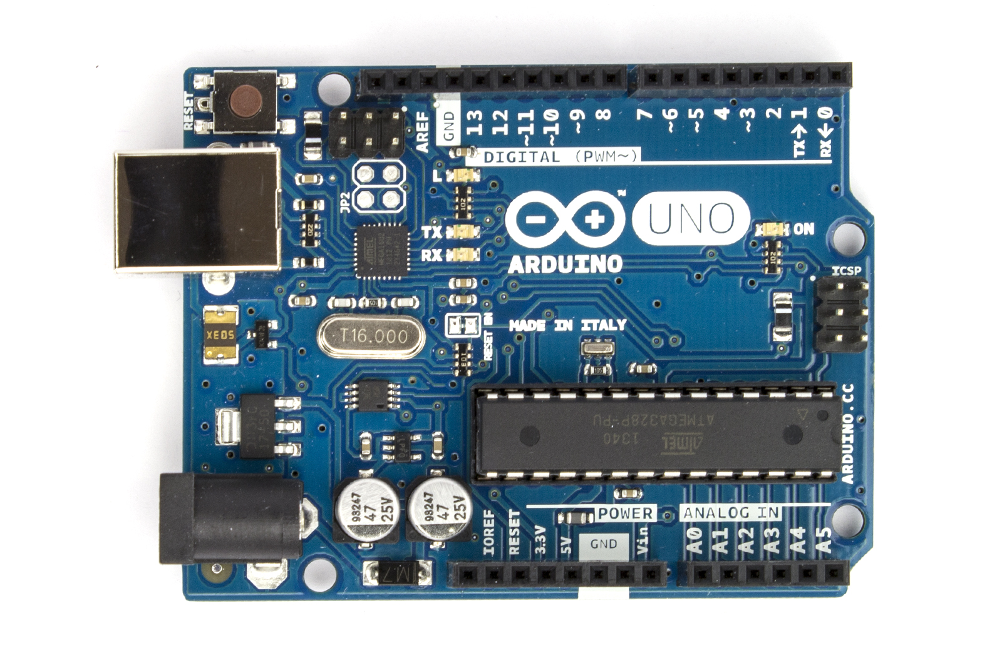

Slide 12
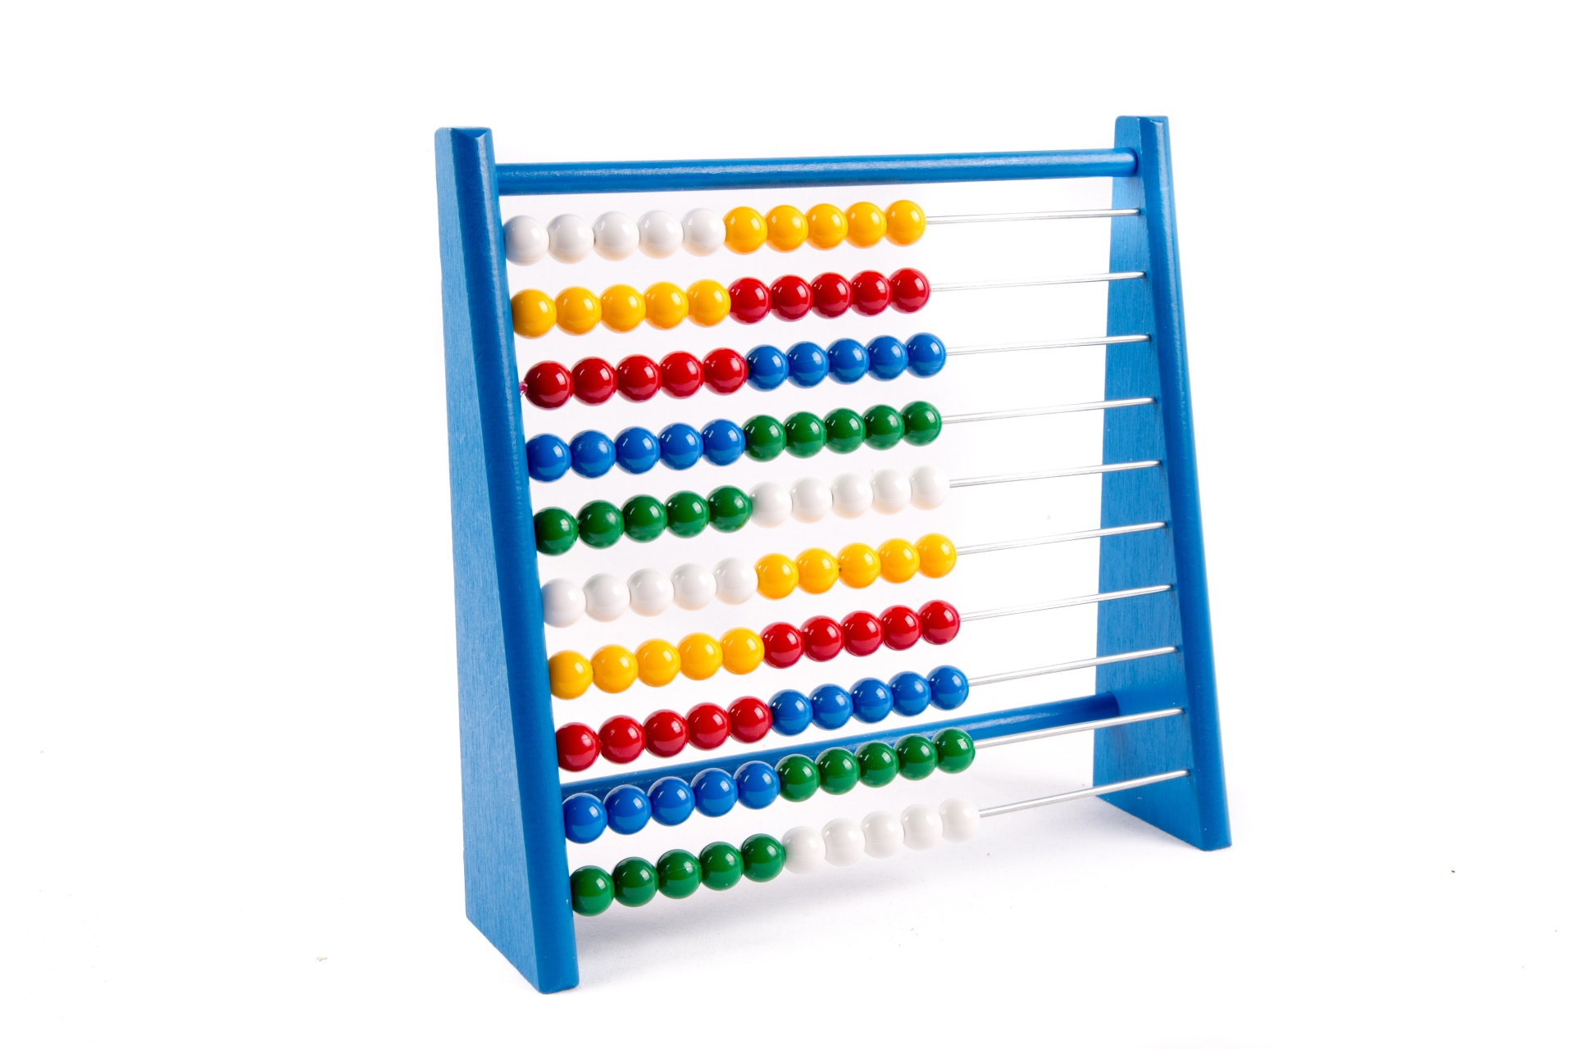

Slide 13
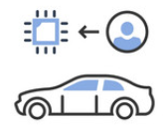
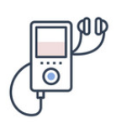
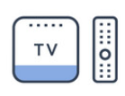
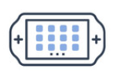

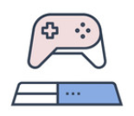

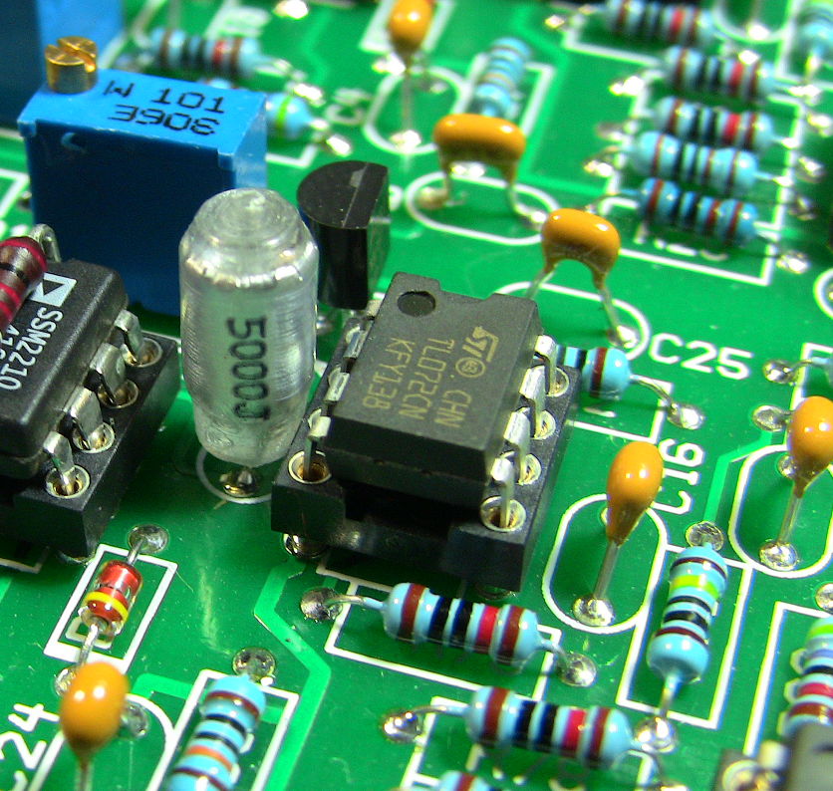





What is a computer?
programable
An electronic device
capaz de recibir información
Made up of electronic components (chips, transistors, capacitors, resistors, cables).
y producir un resultado

Slide 14

What is a computer?
Dispositivo electrónico
programmable
capaz de recibir información
The behavoir of the device can be changed without switching any of its parts
y producir un resultado

Slide 15





What is a computer?
Dispositivo electrónico
programable
can receive inputs
Interacts with its surroundings through sensors: microphones, mouse, thermometer, camera…
y producir un resultado

Slide 16







What is a computer?
Dispositivo electrónico
programable
and process a result
capaz de recibir información
Produces audio, video, games, calculations, analysis, images, etc.

Slide 17
Hardware and Software
Modern computers are made up of a combination of hardware and software.
Hardware includes all physical parts of a computer: processor, cables, storage devices, mouse, screen, etc.
Software is made up of programs: operating system, word processors, graphics editor, etc.

Slide 18
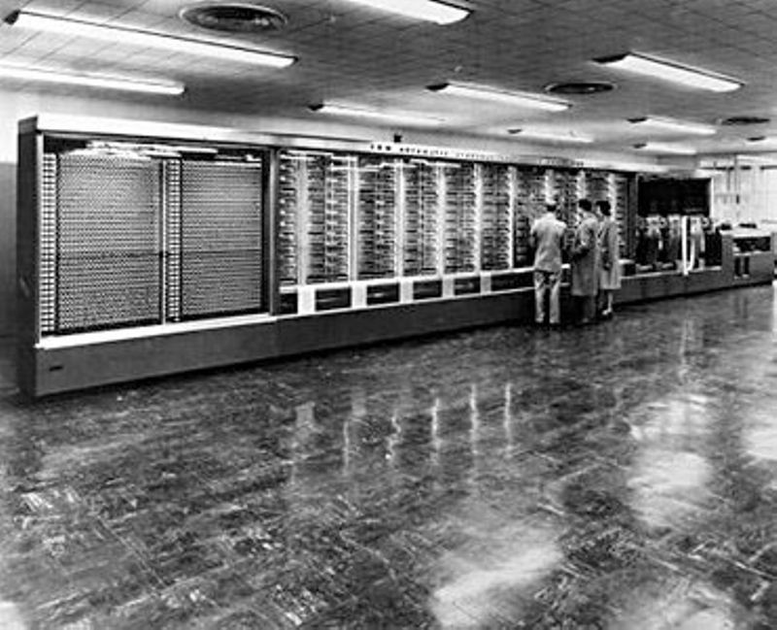
Harvard Mark I – 1944

Slide 19
Hardware

Slide 20
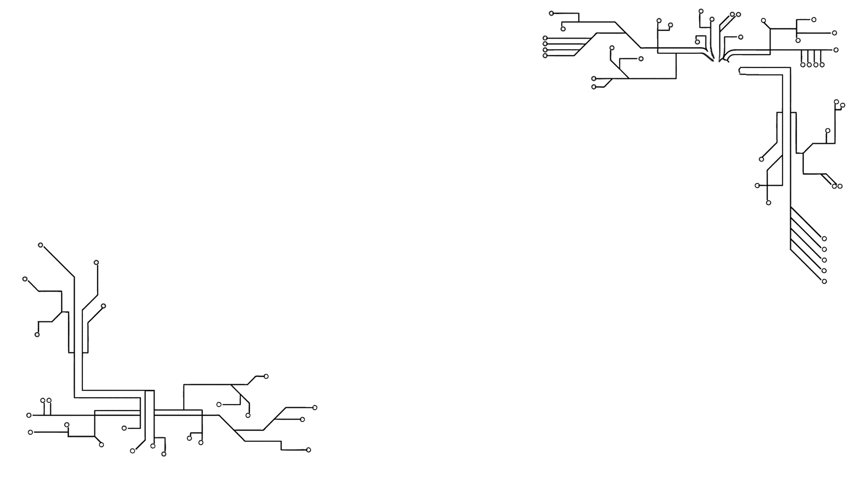
Hardware: Anything in a computer that you can touch

Slide 21
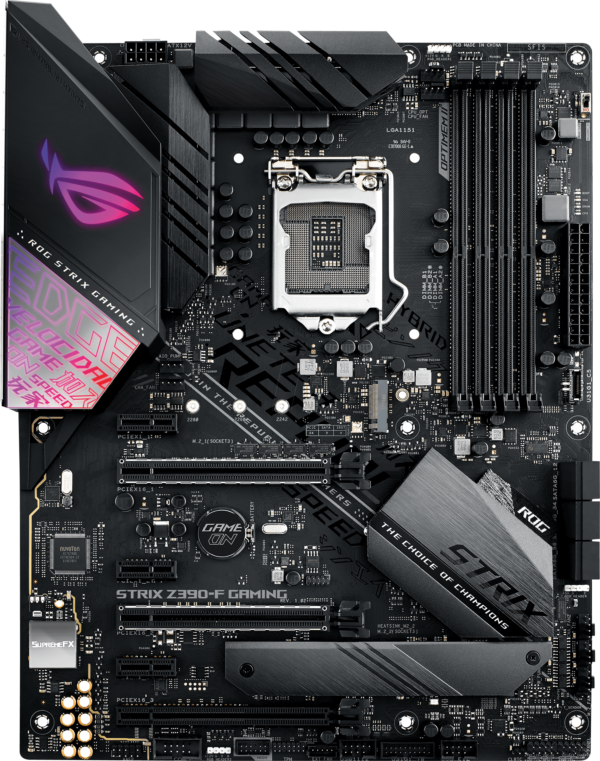
1. Motherboard

Slide 22
1. Motherboard
The motherboard is the computer part that integrates all other computer components.
It allows communication between the electric components of a system.

Slide 23
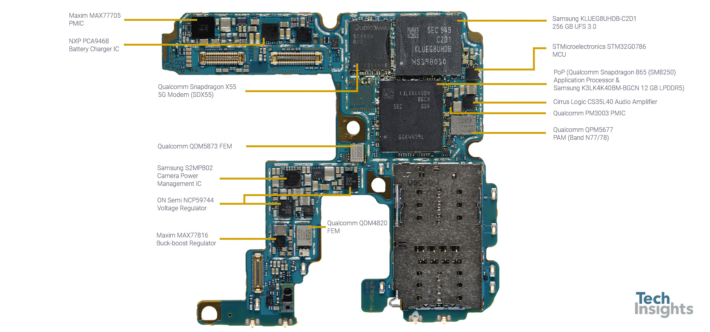
Samsung S20 motherboard. In mobile devices, the motherboard can also be known as the logic board

Slide 24
1. Motherboard

Slide 25
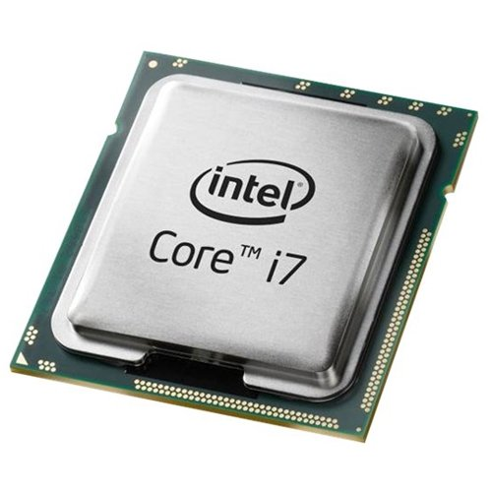
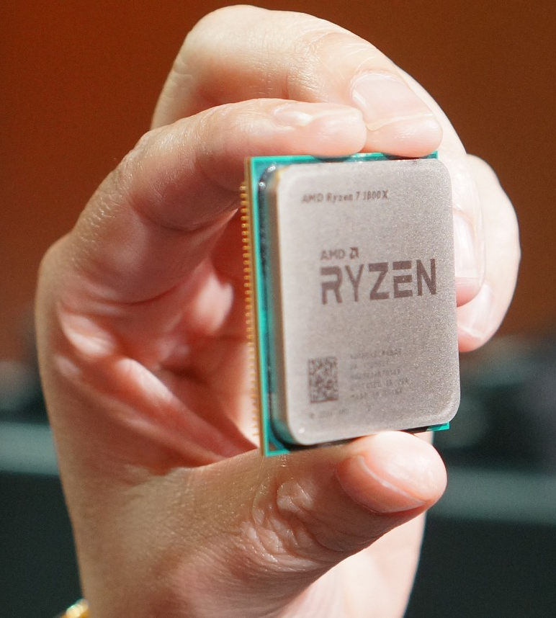
2. CPU – Central Processing Unit
El CPU es el encargado de controlar el flujo, decodificación y ejecución de instrucciones, procesamiento y transferencia de datos.
Sus responsabilidades principales son:
Ejecutar operaciones
Controlar el flujo de ejecución de los programas
Controlar los circuitos internos (activar, desactivar componentes).

Slide 26

2. CPU – Central Processing Unit
The CPU (Central processing unit) is the brain of the computer. It is an electronic circuit that executes program instructions.
Its main responsabilities are:
Executing operations
Controlling the program flow
Turning on/off internal circuits

Slide 27
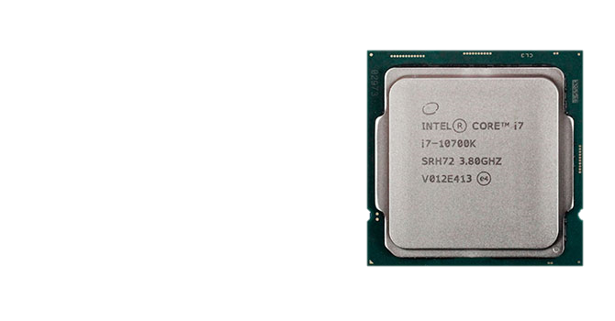
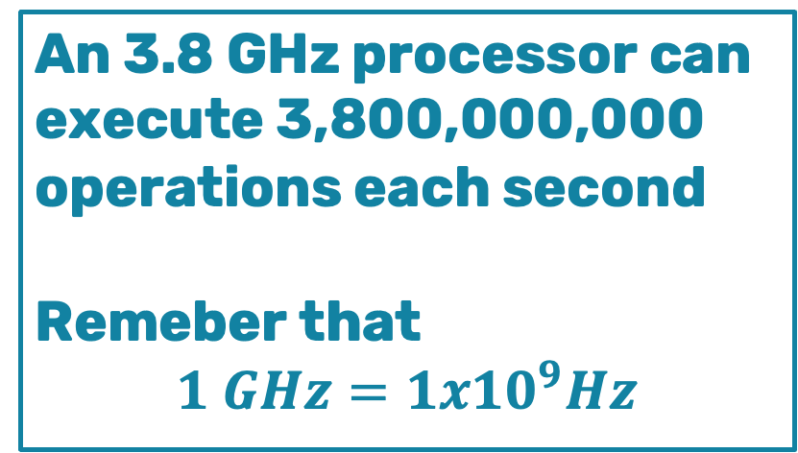
2. CPU – Central Processing Unit
The processor speed is measured in hertz (Hz), which is cycles per second
An 3.8 GHz processor can execute 3,800,000,000 operations each second
Remeber that
$$1 GHz=1x{10}^{9}Hz$$

Slide 28
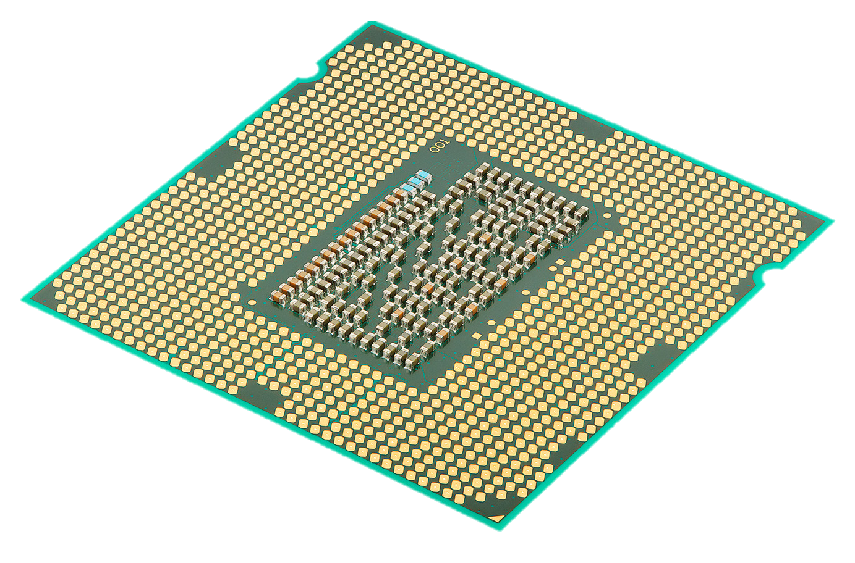
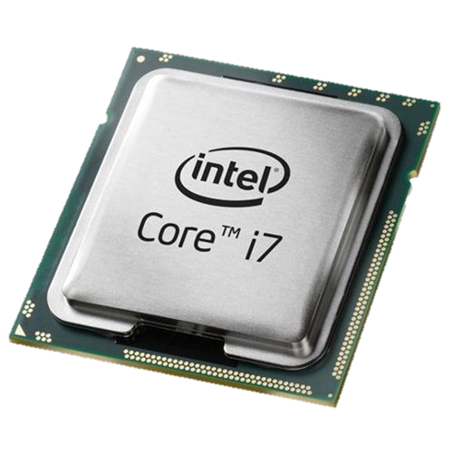
6 cm
8 cm
Intel i7 desktop computer CPU

Slide 29
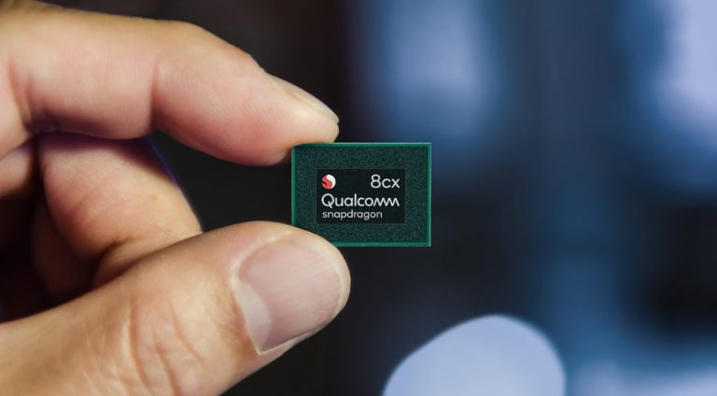

Slide 30
Qualcomm Snapdragon processor for a mobile device

Slide 33
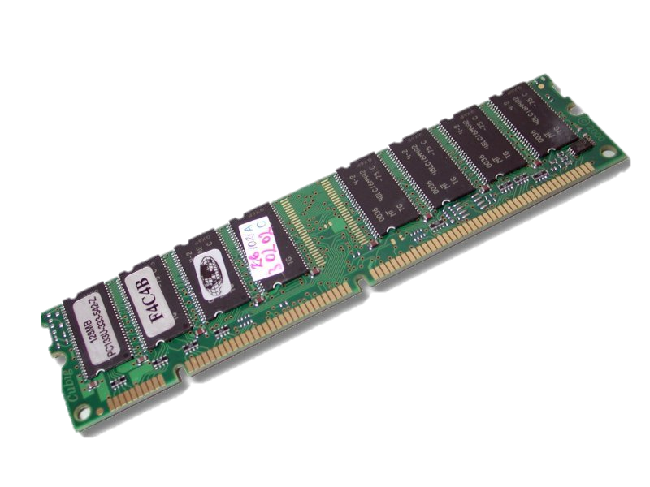
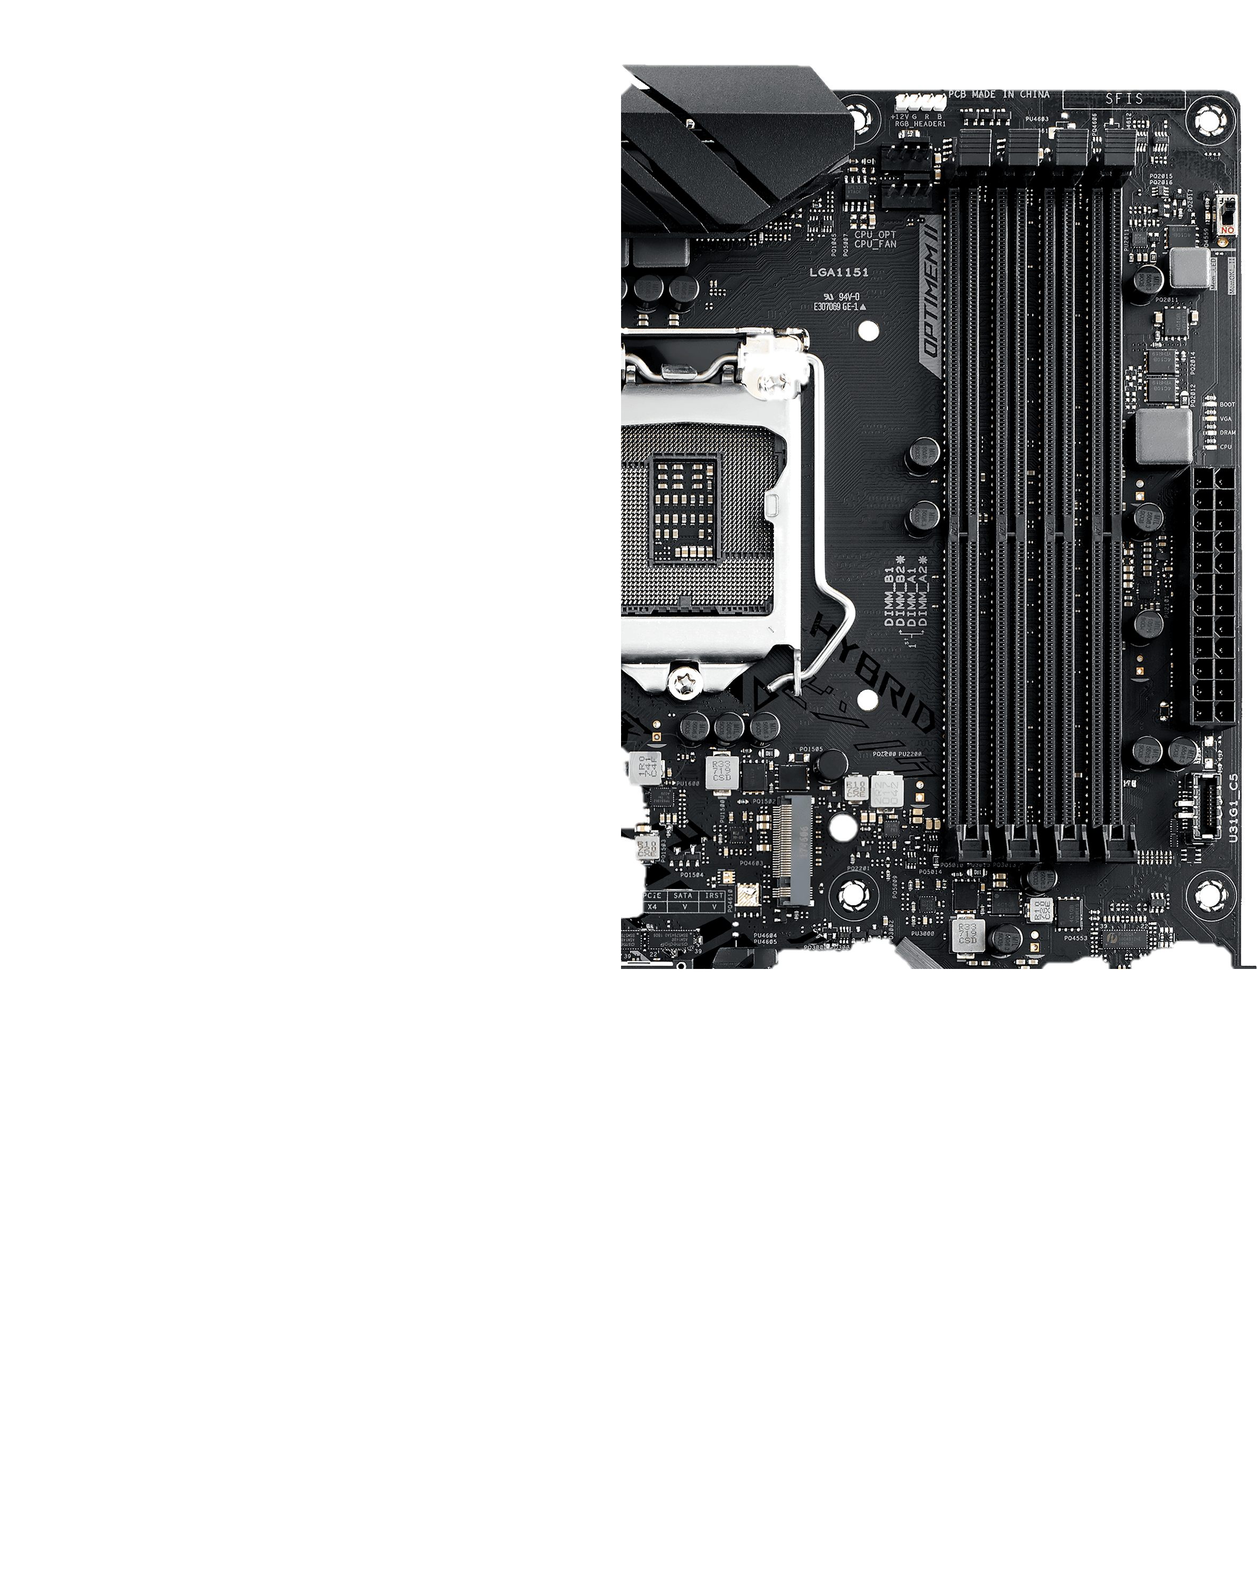
3. RAM – Random Access Memory

Slide 34
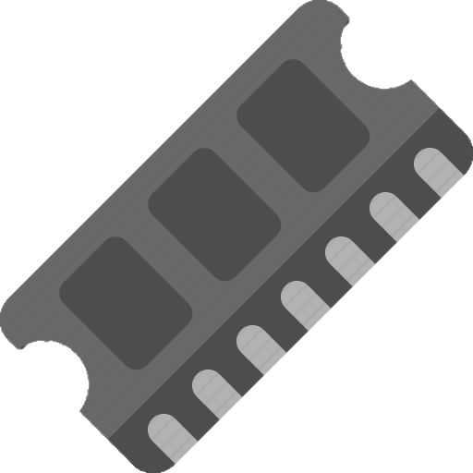
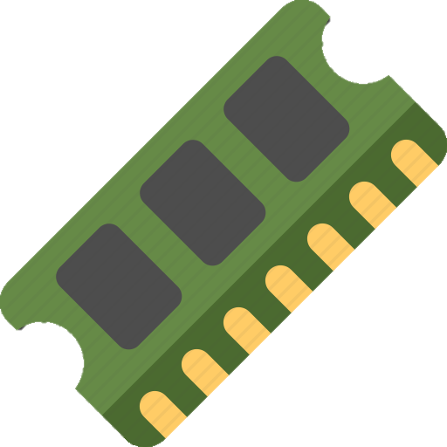



3. RAM – Random Access Memory
RAM memory (random access memory) is part of the computer main memory, or principal memory. It is used to load and execute the operating system, programs, and applications.
It is volatile memory, which means that it requires electricity to operate. If you power off the computer, data will be lost.

Slide 35






3. RAM – Random Access Memory
During runtime, all program data is stored in RAM memory.

Slide 36
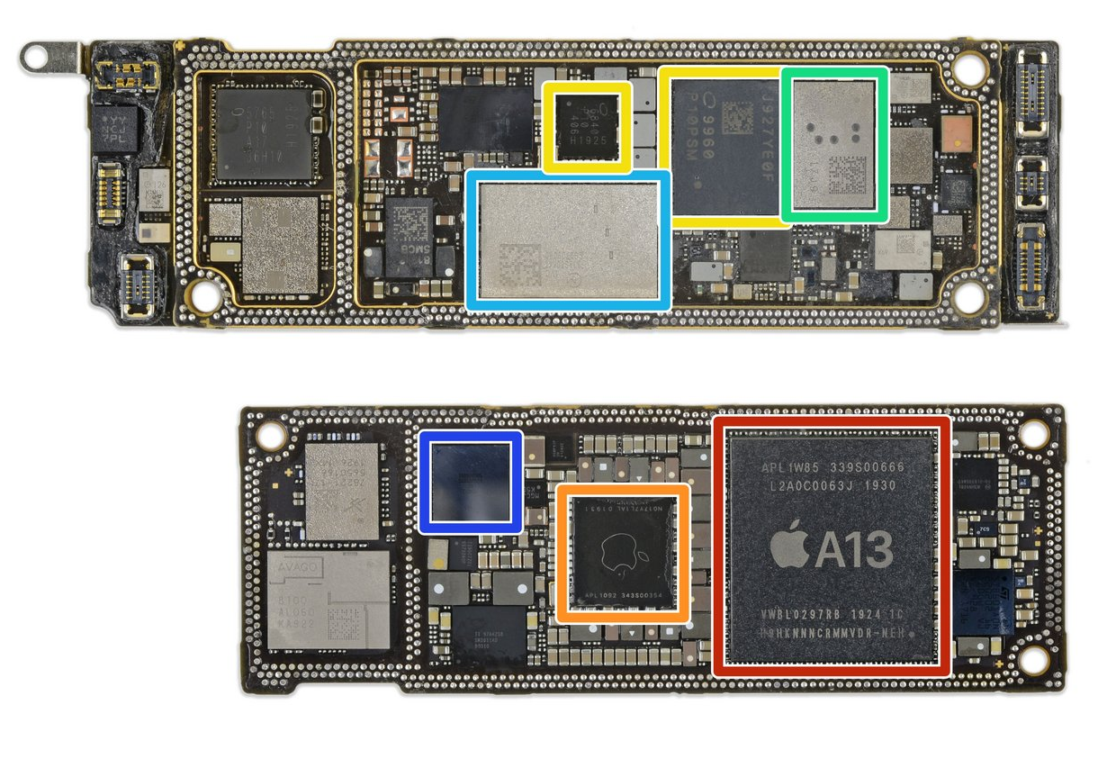
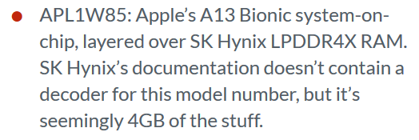

Slide 37
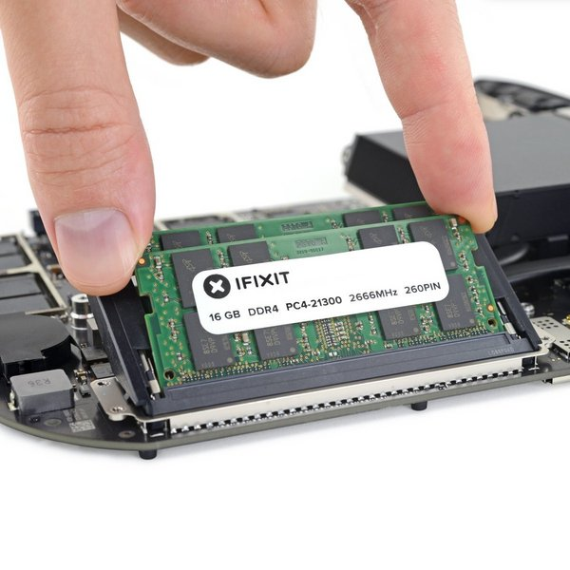
RAM memory is usually measured in Gigabytes (GB).
A modern computer usually has around 8 GB of RAM.

Slide 38

La memoria RAM de una computadora se mide en Gigabytes (Gb).
Una computadora moderna cuenta con 8 GB de RAM.

Slide 40
3. ROM – Read Only Memory

Slide 41
4. ROM – Read Only Memory
ROM memory is part of the main computer memory. It stores critical information for the operation of any computer.
Contradictory to its name, ROM memory Its name comes from not being able to change what this memory is used for.
It is persistent memory, also called non-volatile, which means it does not require energy to store its contents.

Slide 42
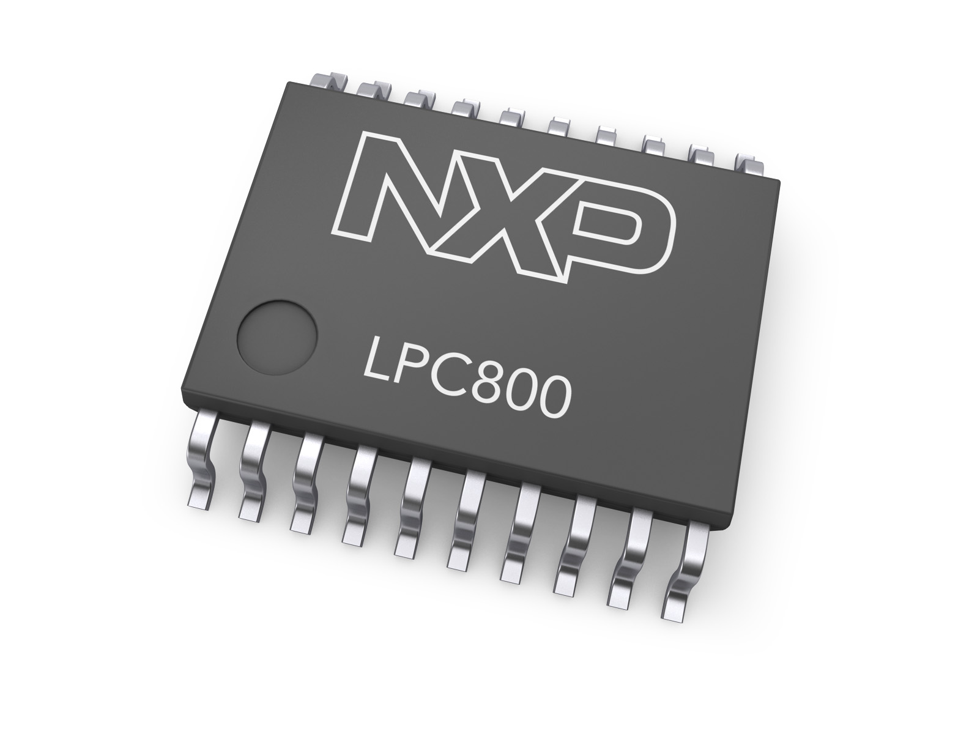
4. ROM – Read Only Memory
Stores the BIOS (Basic Input / Output System), which includes things like:
Processor configuration
Boot sequence
Fan profile

Slide 43
4. Memoria ROM – Read Only Memory
A modern computer usually has 1 MB of ROM memory

Slide 44
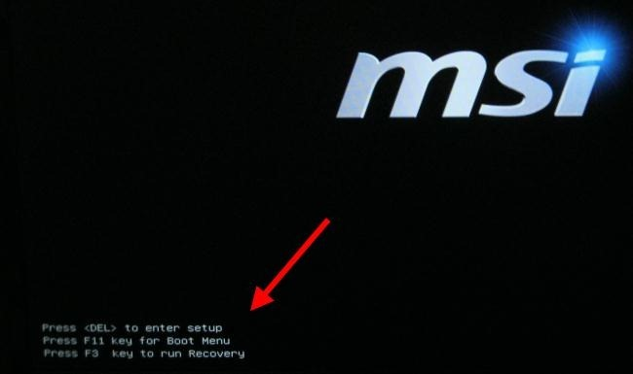

Slide 45
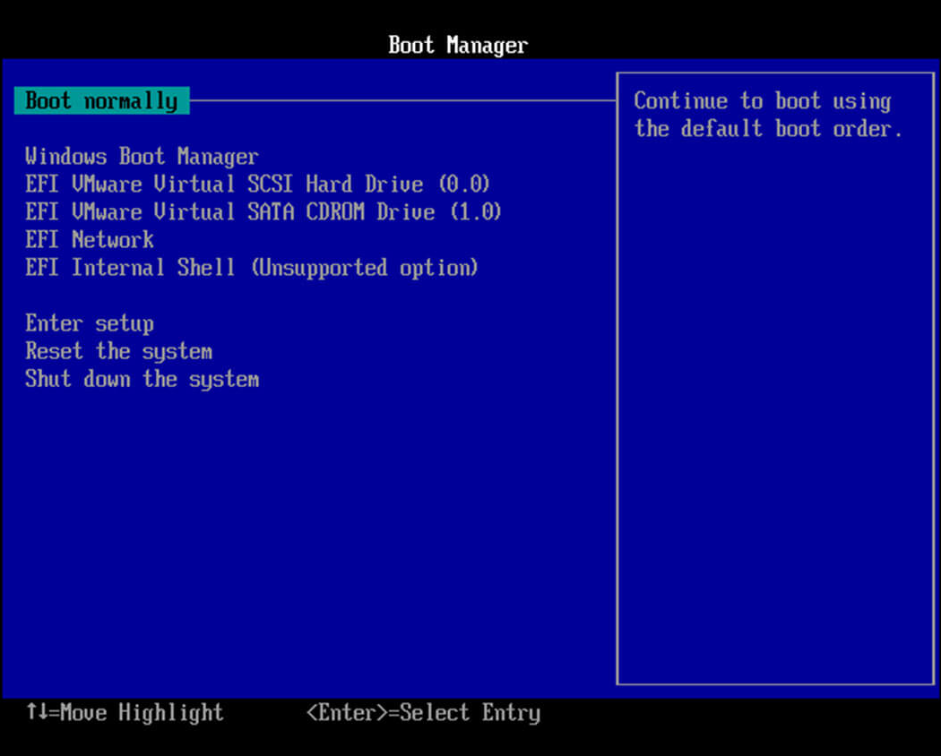
BIOS from a 2000 computer

Slide 46
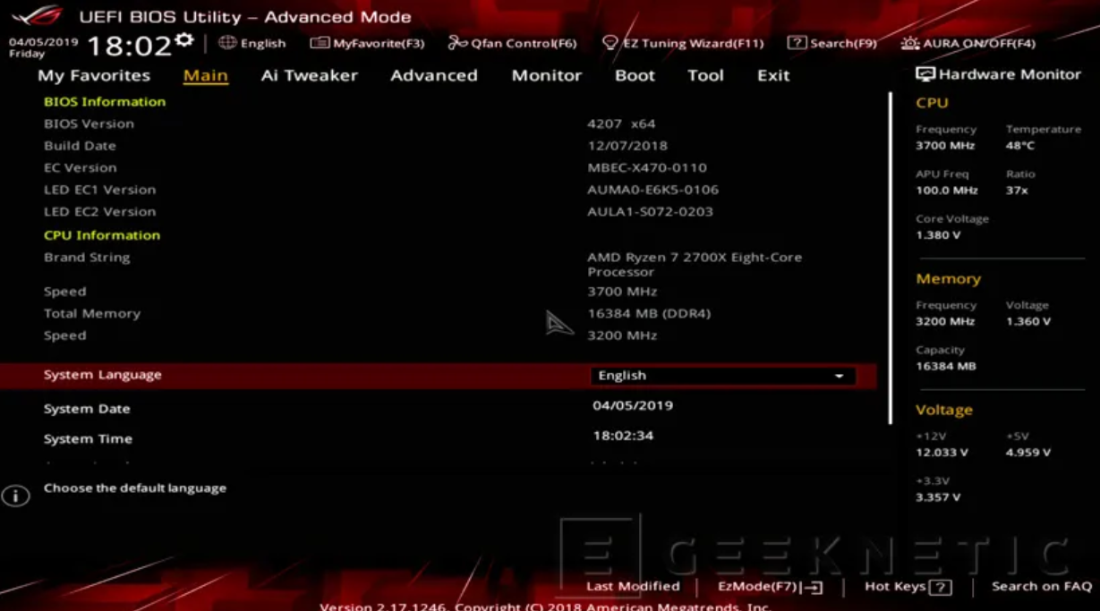
BIOS of a modern computer

Slide 48
5. Secondary Memory

Slide 49
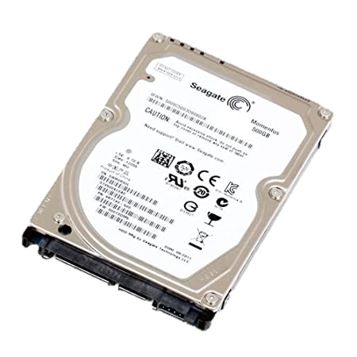
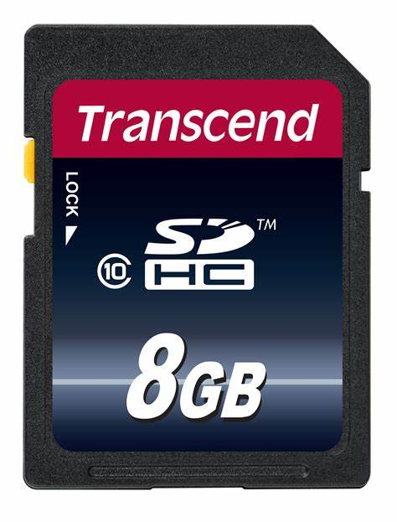
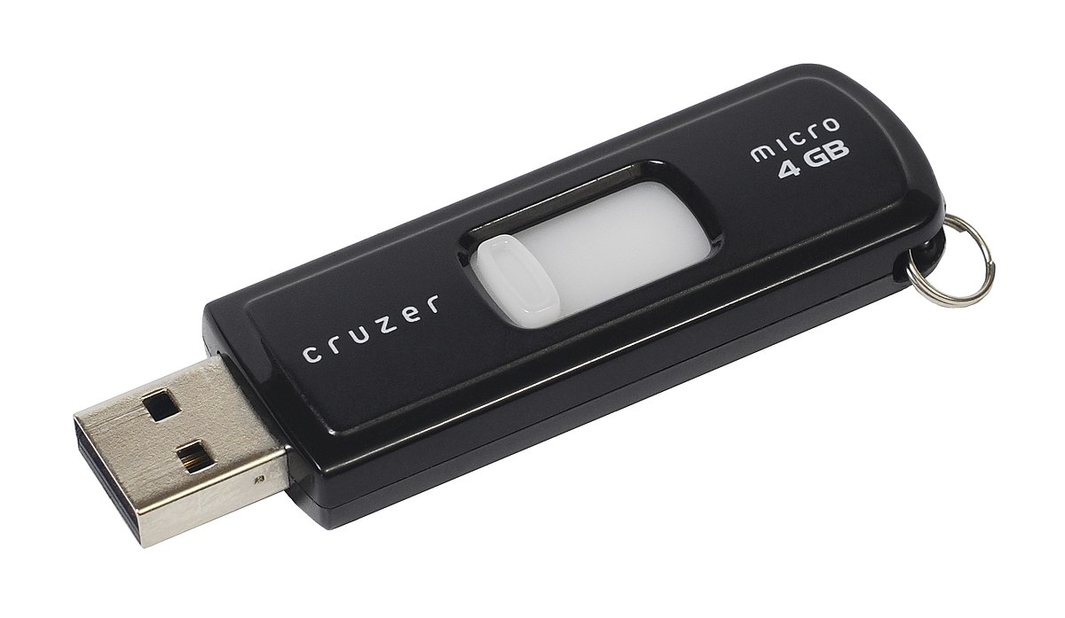
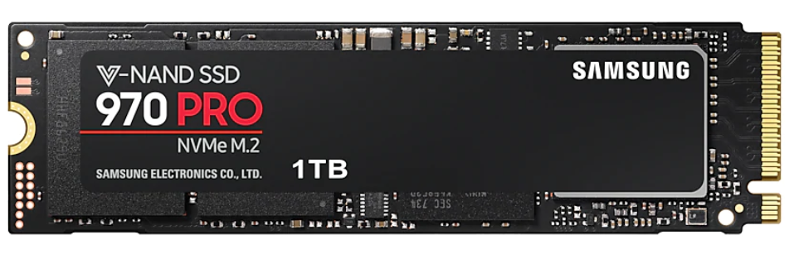
5. Secondary Memory
Secondary memory includes all persistent storage devices that can be connected to a computer.
Hard disk drive. (HDD)
Solid state drive. (SSD)
USB flash drive
SD Card (SD)

Slide 50
5. Memoria Secundaria
Almacenan fotos, documentos, imágenes, archivos de texto, video, etc.

Slide 51
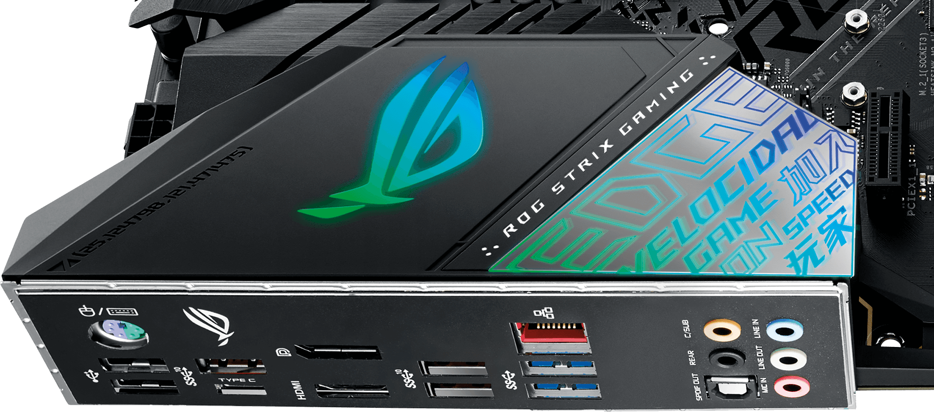
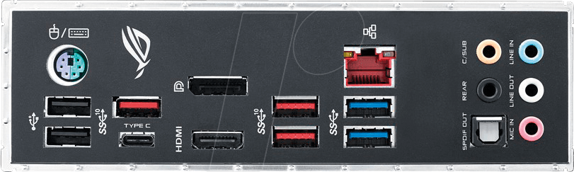
6. Peripheral Devices

Slide 52



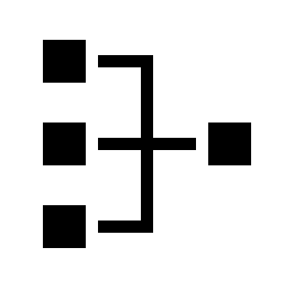
6. Peripheral Devices
A hardware device that is connected to a computer to transfer information into and out of a computer is considered a peripheral device. They are also called I/O devices (input/output).
Mouse and keyboard
Microphone
Gamepad
Network controller

Slide 53


6. Peripheral Devices
Input Devices
Output Devices
Some devices work as both input / output

Slide 55
Von Neumann computer architecture

Slide 56
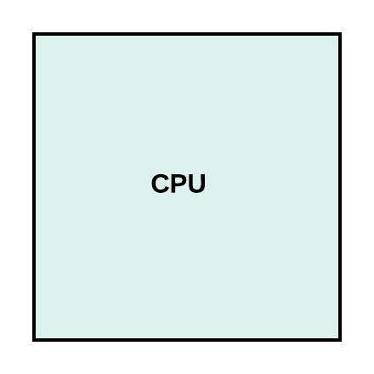

Slide 57


Control Unit
It controls the instructions to execute, and in which order.
Interprets every instruction
Keeps track of the computer clockrate (like a metronome!)
Control Unit

Slide 58

ALU – Arithmetic Logical Unit
It performs logical operations (ANDs, ORs, NOTs).
Executes comparisons
Executes arithmetic operations such as additions, subtractions, etc.
Control Unit
ALU

Slide 59

Cache memory
Cache is a small amount of memory that is used to store frequently accessed data and instructions.
Cache memory is faster but has a smaller capacity than RAM
Cache
Control Unit
ALU

Slide 60
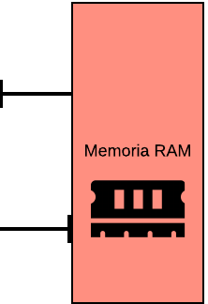
Cache
RAM
Control Unit
ALU

Slide 61
Software

Slide 62
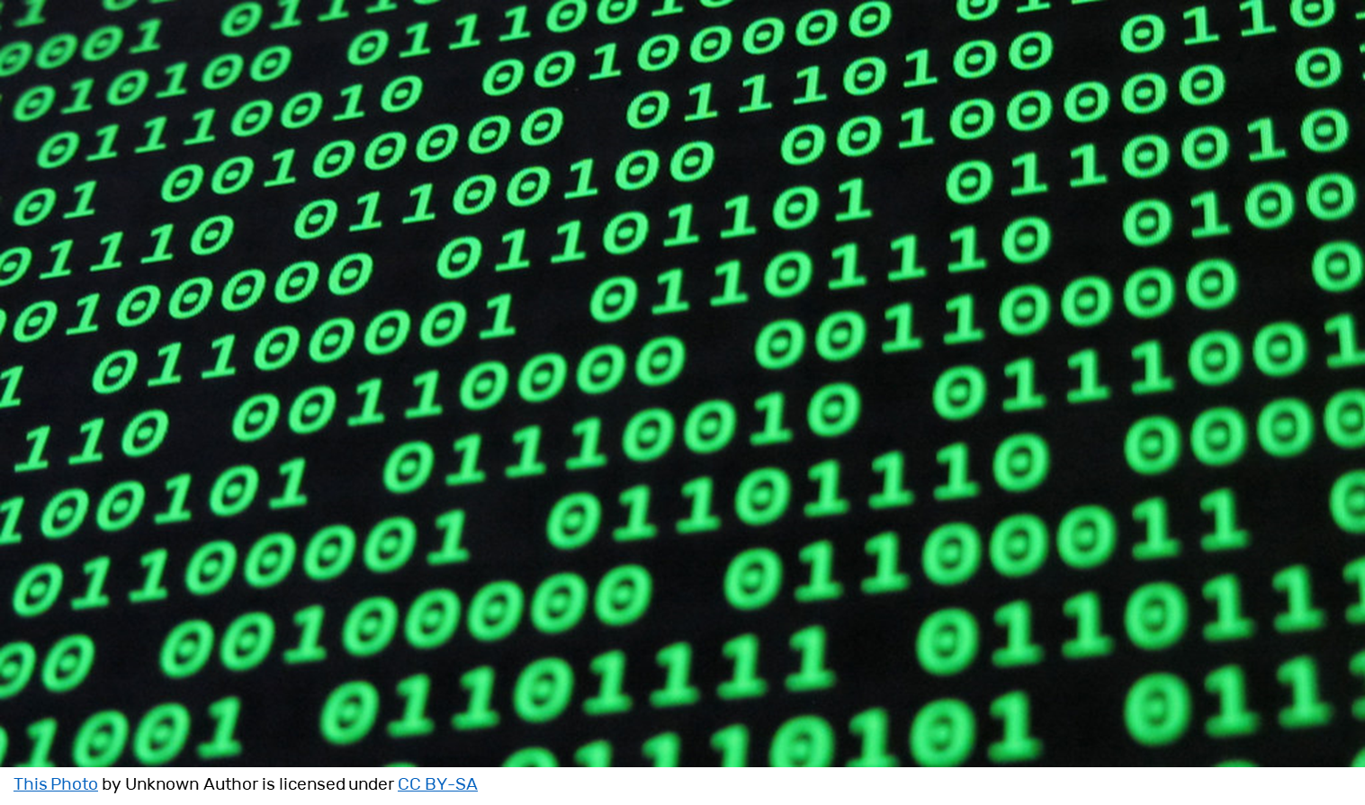
Software: “Everything a computer is programmed to do”

Slide 63
Software
Software is a set of instructions that is executed by a computer to perform a result.
Software complexity can vary widely – it can be a simple math calculation, or an operating system with hundreds of thousands of lines of code.
Software can be mainly classified into two groups:
System software
Application software

Slide 64
System software
How many operating systems can you name?

Slide 65

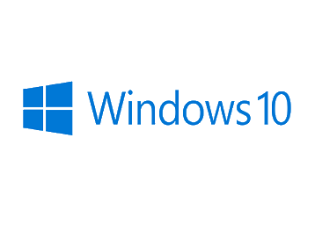




Slide 66
System Software – Operating Systems
An operating system is the bundle of programs in charge of administrating and managinig a set of hardware resources
All operating systems manage four main resources:
Task
File
Memory
Device

Slide 67
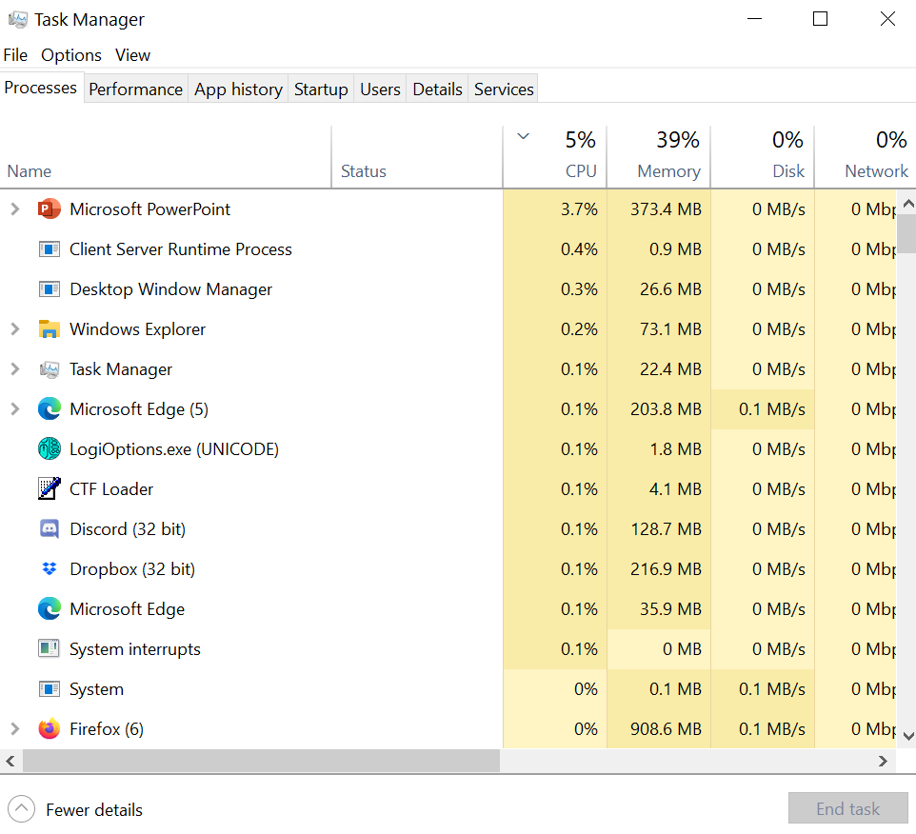
Administrador de Procesos
Task
File
Memory
Device

Slide 68


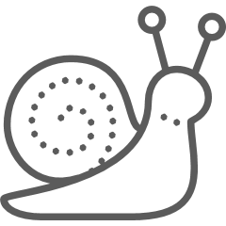
Task Manager
Task
The task manager is in charge of all tasks or processes running in a computer.
Balances the CPU load so that multiple programs can be executed simultaneously
Orders and executes tasks based on priority.
File
Memory
Device
Mayor prioridad
Menor prioridad

Slide 69





File Manager
Task
This manager is in charge of controlling access to all files.
It organizes data stored in secondary memory
It has tools to visualize and interpret files.
File
Memory
Device

Slide 70
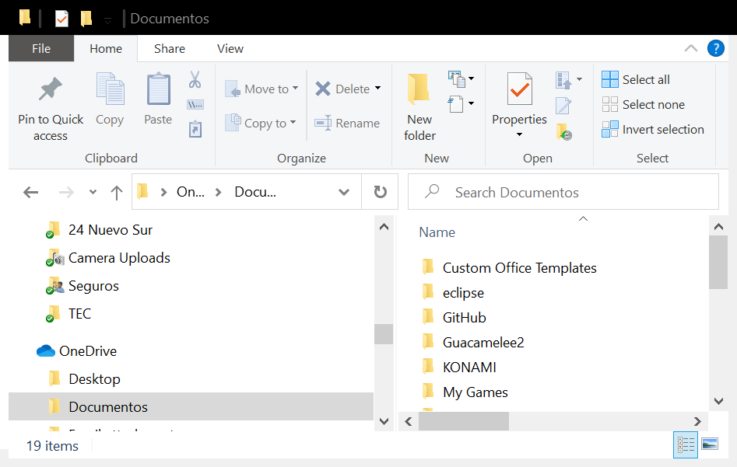
File Manager
Task
File
Memory
Device

Slide 71


File Manager
Task
File
Memory
Device

Slide 72


Memory Manager
Task
Memory manager handles RAM allocation on each process.
Since RAM is a finite resource, it is important to assign and free it intelligently.
File
Memory
Device

Slide 73

Memory Manager
Task
File
Memory
Device

Slide 74

Device Manager
Task
It is the translator between each hardware device and its operating system
Utilizes drivers to communicate effectively
Some peripheral devices (mice, keyboards) support generic drivers, such as HID – Human Interface Device.
File
Memory
Device

Slide 75

Device Manager
Task
File
Memory
Device

Slide 76

Device Manager
Task
File
Memory
Device

Slide 77
Application Software
How many applications can you name?

Slide 78










Slide 79





Application Software
Company
Recreational
Security
Learning
Admin
….y muchos mas!!!

Slide 80


Slide 81



Malware (Malicious Software)
Computer that makes its way to a computer with the intention of damaging the user.
It copies and replicates by itself, infecting other programs and files
Replicates to other devices connected in the same network
Infiltrates a computer to spy on its users, stealing sensible information
Virus
Worm
Spyware

Slide 82



Malware (Malicious Software)
Enters your computer disguised as an unoffensive file
Blocks access to your computer until a ransom is payed
Displays unwanted pubilicity while the computer is operated
Trojan
Ransomware
Adware

Slide 83


Malware (Malicious Software)
Logs and stores all
Gains admin access to a a device, allowing it to install other malicious software
Keylogger
Rootkit

Slide 84


